Slide 1
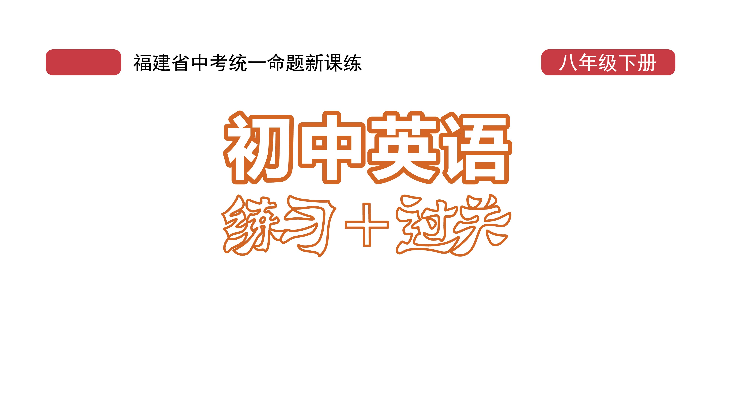
课时练习
模块八 第二章 第三节

Slide 2
一、翻译下列词组。
1. 保护…… 免受…… ________________________
2. 穿着 ______________________
3. 从……获得帮助 _________________________
4. 疾病的传播 ____________________________
protect … from …
dress in/be in
get help from …
the spread of diseases

Slide 3
一、翻译下列词组。
5. 在（某人的）日常生活中 _____________________
6. 休闲服； 便服 ______________________________
7. 在某人看来 ___________________________
8. 由于不同的原因 __________________________
in (one’s) daily life
casual clothes
in one’s opinion/view
for/because of different reasons

Slide 4
二、用括号内所给单词的适当形式填空， 每空一词。
1. The menu changes regularly and there are ______ (day) specials（特色菜） to choose from.
2. Mobile cabin hospitals(方舱医院) play a huge role in treating ________ (patient).
3. People would benefit(受益) _______ (great) from a pollution-free vehicle.
daily
patients
greatly

Slide 5
二、用括号内所给单词的适当形式填空， 每空一词。
4. The girl sang _____________ (beautiful) at the party last night.
5. The big fire quickly________ spread) to another building.
beautifully
spread

Slide 6
三、情景交际。
1. 你想知道飞机何时起飞， 可以这样问机场工作人员：
Could you please tell me _________________________?
2. 你想了解制服的作用是什么， 可以这样问对方：
______________________________________________?
3. 你想了解朋友购物的频率， 可以这样问他：
Can you tell me ________________________________?
when the plane will take off
What are the functions of uniforms
how often you go shopping

Slide 7
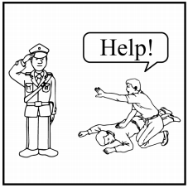
四、看图写话。
1. get, in trouble
People can get help from the police when (they are) in trouble.

Slide 8
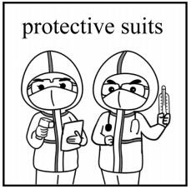
四、看图写话。
2. protect, disease
Protective suits protect doctors against diseases./
The doctors wear protective suits to protect themselves from the disease.

Slide 9
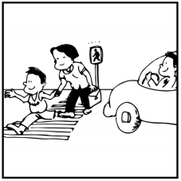
四、看图写话。
3. important, obey
It’s important that people obey the traffic rules./
It’s important (for people) to obey the traffic rules.

Slide 10
五、熟词生义。
1. text A. n. 正文， 文本
B. vt. (用手机给某人)发短信
_____ (1) Text me as soon as you get your exam results.
_____ (2) Read the text carefully and then answer the questions.
B
A

Slide 11
五、熟词生义。
2. patient A. n. 病人
B. adj. 有耐心的
____ (1) You need to find a patient teacher.
____ (2) We hope this book will act as a bridge between doctors and patients.
B
A

Slide 12
五、熟词生义。
3. reason A. n. 原因； 理由
B. vt. 推理； 推断
____ (1) We’d like to know the reason why she didn’t accept the job.
____ (2) She reasoned that she must have left her bag on the train.
A
B

Slide 13


